Slide 1
College Affordability
Invest in Your Future

Slide 2
Cost of Attendance
Direct Costs:
Tuition & Fees
Housing & Meal Plan (Room & Board)
Indirect Costs:
Books & supplies
Transportation
Personal

Slide 3
2019-2020 University of Tennessee
Estimated Average Cost of Attendance
*All costs presented are only estimates for the 2019-2020 academic year. Official costs set in late June 2019
Direct Costs | In-State
Tuition & Fees | $13,264
Room & Board | $11,482
Mandatory Costs Total | $24,746
Books | $1,598
Transportation | $1,664
Personal | $4,002
Total | $32,010

Slide 4
Applying for Financial Aid
Free Application for Federal Student Aid (FAFSA)
www.fafsa.ed.gov
Application assesses family’s ability to pay – EFC
Used to determine eligibility for all types of aid
Required for TN State funding and some UT funding
Different deadlines for federal, state, institutional funding

Slide 5
Forms of Financial Aid
FAFSA needed to determine eligibility for some aid
Grants – Funding that is not repaid
Scholarships – Funding that is not repaid
Federal Work Study – Part-time employment
Federal Student & Parent Loans – Must be repaid
Private Loans – Last resort for borrowing as terms for private loans usually not as good as federal loans

Slide 6
UTK Scholarships
UT Competitive & Departmental Scholarships
Apply for Admission Nov 1 and scholarships app by Dec 15
Award amounts vary - up to $10,000 per year
FAFSA by Jan 15 for need based awards
UT Volunteer Scholarships (4 year award)
Apply for Admission by December 15
Must have 3.8 weighted core GPA (updated GPA through end of school year)
ACT/SAT super-score (earned by December senior year)
ACT/SAT Score | Annual Award
34–36 / 1490–1600 | $8,000
30–33 / 1360–1480 | $5,000
28–29 / 1300–1350 | $3,000

Slide 7
UTK Scholarships
UT Pledge Scholarship
Apply for Admission by December 15 and file FAFSA by Jan. 15
Total Family Income < $40,000
Covers Mandatory Costs (last dollar award)
UT Promise Scholarship
UT Promise is a last-dollar, undergraduate scholarship that will guarantee free tuition and mandatory fees to qualifying Tennessee residents enrolling at UT campuses. See handout provided for more information.
For up to date information on all UTK Scholarships please visit https://onestop.utk.edu/scholarships/entering-freshmen/

Slide 8
State of TN Programs
Hope Scholarship
Graduate from a TN high school
Student/Parent must be TN resident on FAFSA
3.0 GPA or 21 Composite ACT to qualify
Annual FAFSA Required
Tennessee Student Assistance Award
EFC <$2100
File FAFSA as early as possible
For additional awards and up to date information including deadlines visit https://www.tn.gov/collegepays/financial-aid.html

Slide 9
HOPE Scholarship
General Assembly Merit (GAM) Supplement: 3.75 and 29 Composite ACT
Aspire Supplement: <$36,000 Parent AGI
Annual Award Amounts:
Freshman/Sophomore Level | $3500
Junior/Senior Level | $4500
ASPIRE Supplement | $1500
GAM Supplement | $1000
Summer awards available – after the freshmen year

Slide 10
External Resources
Your Guidance Counselor
Parent Employer
Churches/Religious Centers
Local Businesses – contact small local business regarding scholarship opportunities
Community/Civic Organizations – contact non-profit/community service organizations such as fraternities/sororities, Urban League, or YMCA/YWCA

Slide 11
External Resources
Private Corporations - explore the websites of companies with whom you do business with such as Wal-Mart, Kroger, Coca-Cola, Pepsi, etc.
National/State/Local Associations - search for associations that match your career interests, personal interests, occupation, ethnicity, etc. (ex. National Society of Professional Engineers) Note: some associations may require membership.
Scholarship Search Services – Fastweb (www.fastweb.com), Finaid.org (www.finaid.org), etc.
Exercise caution when searching online!

Slide 12
Loan Wisdom
Borrow Federal first because they are less expensive, more available, and have better repayment terms than private student loans.
Live like a student while you’re in college, so you don’t have to live like one after college.
Do not borrow more for your entire education than your expected starting salary after you graduate.
If you are borrowing an excessive amount each year, consider the total borrowed in 4 years.

Slide 13
One Stop Student Services
Net Price Calculator

Slide 14
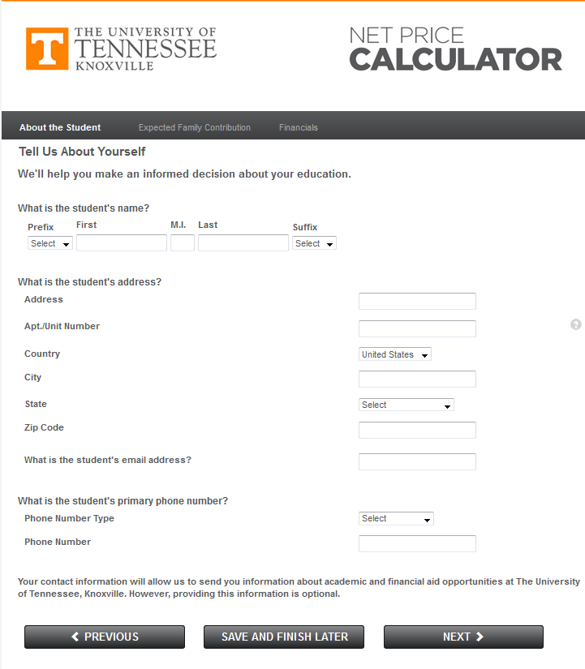

Slide 15
College Choice
Review all offers and compare financial aid offered with the institution specific cost of attendance
Reflect on academic offerings as well as the scholarship and financial aid offered to you
Request additional information about opportunities for subsequent school years of attendance
Respond to all colleges & universities as your decline can impact the life of a wait listed applicant for admissions and an alternate for scholarships

Slide 16
Thank you! Questions?
Get in touch with a One Stop Counselor
In person
By phone: 865-974-1111
By email: onestop@utk.edu

